Slide 1
Programming languages:
C and C++

Slide 2

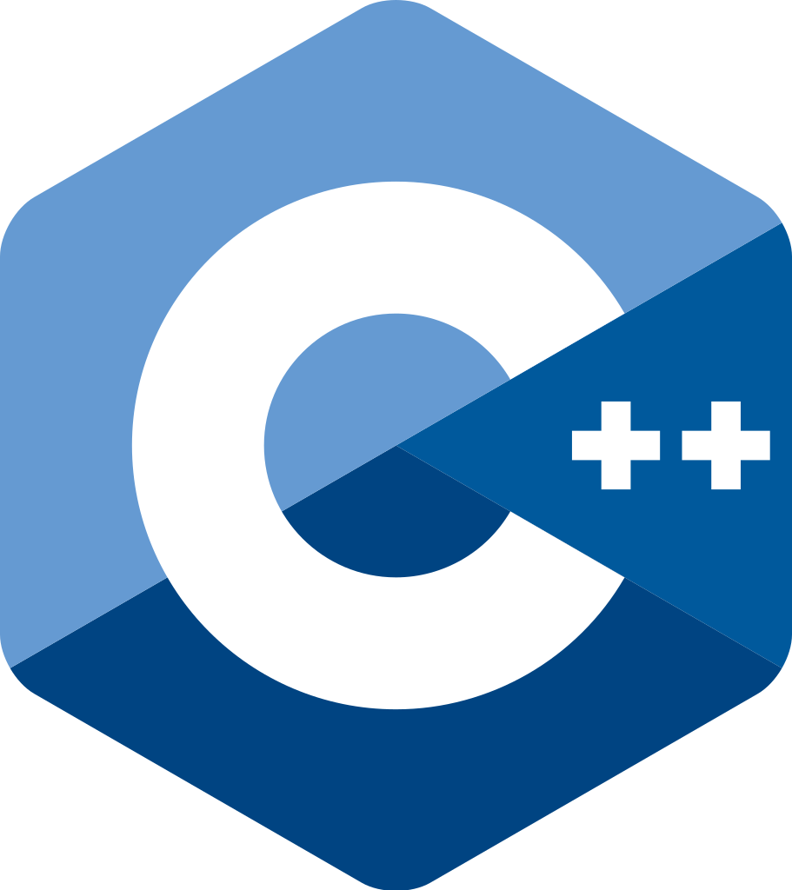
Introduction to C and C++
C was developed in 1972 at Bell Labs by Dennis Ritchie
C++ was developed in 1985 by Bjarne Stroustrup as an extension of C
General purpose languages
Both are very fast & efficient
They provided the groundwork for many modern languages

Slide 3
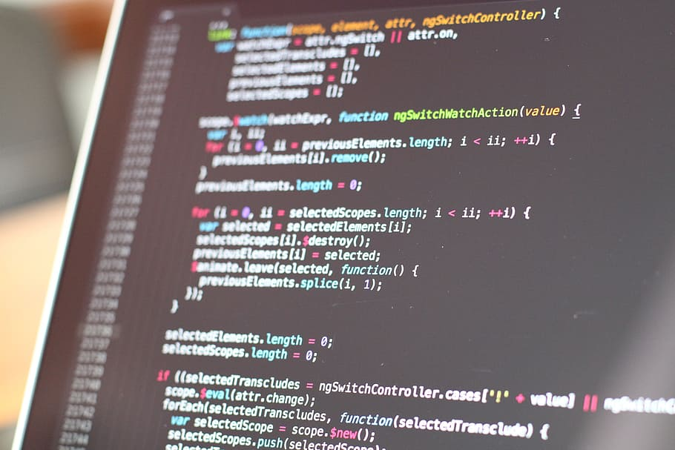
C and C++ Syntax Characteristics
Use of curly braces `{}` for defining blocks of code
Semicolon `;` to end statements
Low-level memory access capabilities
C++ introduces features like classes, objects, and templates

Slide 4
Basic C Code Example
#include <stdio.h>
int main() {
printf("Hello, C World!");
return 0;
}

Slide 5
Basic C++ Code Example
#include <iostream>
int main() {
std::cout << "Hello, C++ World!";
return 0;
}

Slide 6
Strengths of C and C++
Efficient and fast execution
Fine-grained control over hardware resources
Direct low-level memory access
C++ supports both procedural and object-oriented programming
Extensive libraries and tools available

Slide 7
Weaknesses and Criticisms
Manual memory management can lead to issues like memory leaks in C
C++ can be complex due to its extensive feature set
Steeper learning curve, especially for beginners
Can be complex and hard to debug
Both languages give developers a lot of freedom but also responsibility for lower-level details most modern languages handle automatically

Slide 8
Use Cases
Operating systems and system programming
Databases
Game development
High-performance applications and simulations
Embedded programming (especially C)
Anything where performance is critical

Slide 9
Thank you!
Q & A

